Slide 1
Intro to Data Science - Midterm 8/8
Madeleine Clark

Slide 2
Concept:
Assessing the potential impact of accessible care and reproductive rights on women’s mental health

Slide 3
Broad scope:
Can we isolate a correlation between access to women’s health and reproductive care and the prevalence of mental health issues in women?

Slide 4
Source: 2009 WHO report
“Mental health problems may develop as a consequence of reproductive health problems or events. These include lack of choice in reproductive decisions, unintended pregnancy, unsafe abortion, sexually transmissible infections including HIV, infertility and pregnancy complications such as miscarriage, stillbirth, premature birth or fistula. Mental health is closely interwoven with physical health.”

Slide 5
Impetus for study:
There is increasing political support for removing PP from Title X, effectively “defunding” the program (source)
Without PP, there aren’t enough providers to meet the current need (source)
Depression rates are alarmingly high among reproductive-aged women, and pinpointing contributing variables can help us begin to address them (source)

Slide 6
Narrow scope:
Is the relative provision and accessibility of care correlated with lower rates of depressive episodes in women?

Slide 7
Assumptions:
Prevalence of one or more major depressive episodes in the last year indicates a negative impact on mental health
Number of PP sites reflects relative ease of access to their services
All PP centers provide roughly equal levels of care

Slide 8
Methods:
Data Collection
URL Scraping
Pandas read_csv
Packages and Libraries
Pandas
Matplotlib
Seaborn

Slide 9
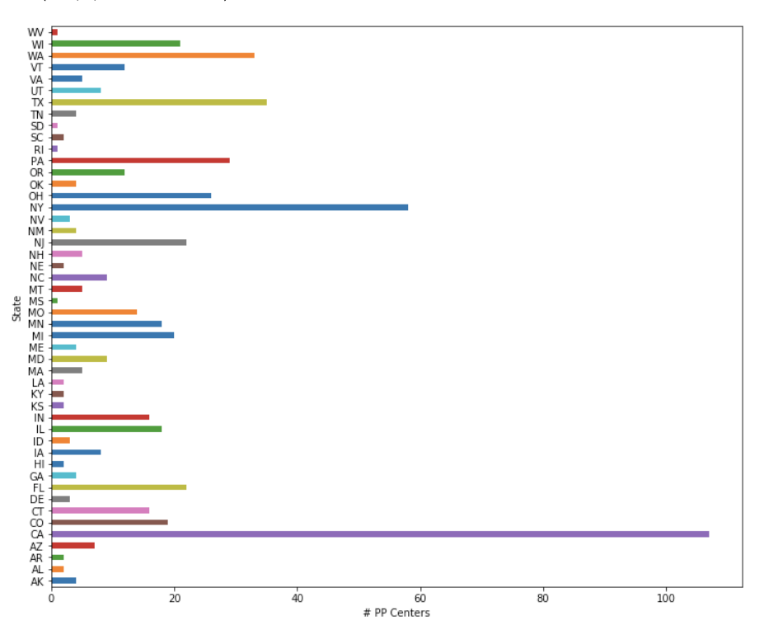
State-by-state provision of care:

Slide 10
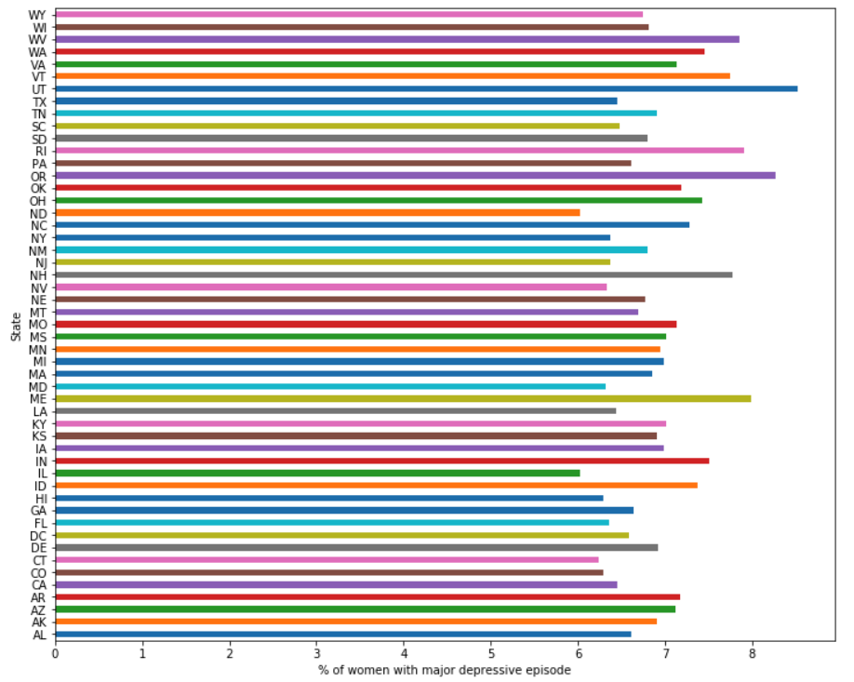
State-by-state rates of depression:

Slide 11
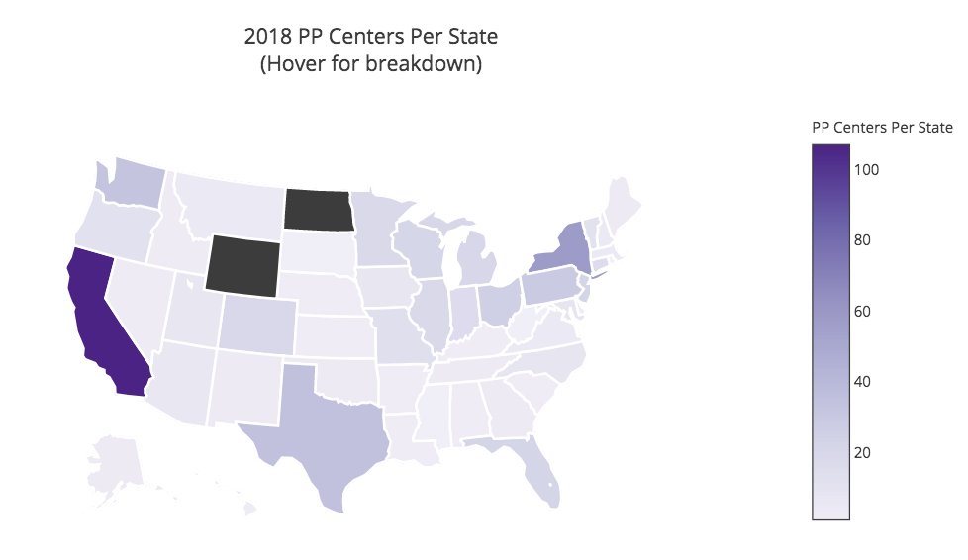
Concentration of care:

Slide 12
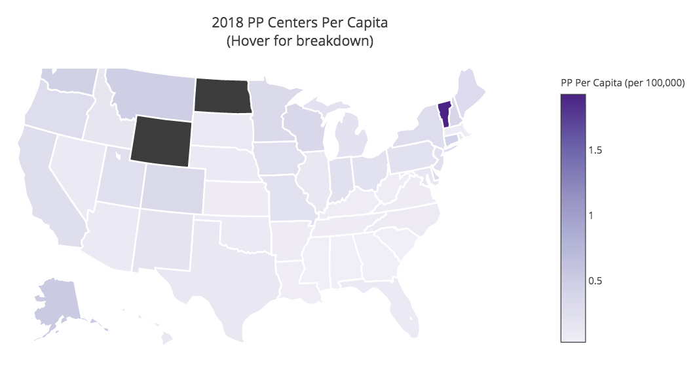
Provision of care per capita:

Slide 13
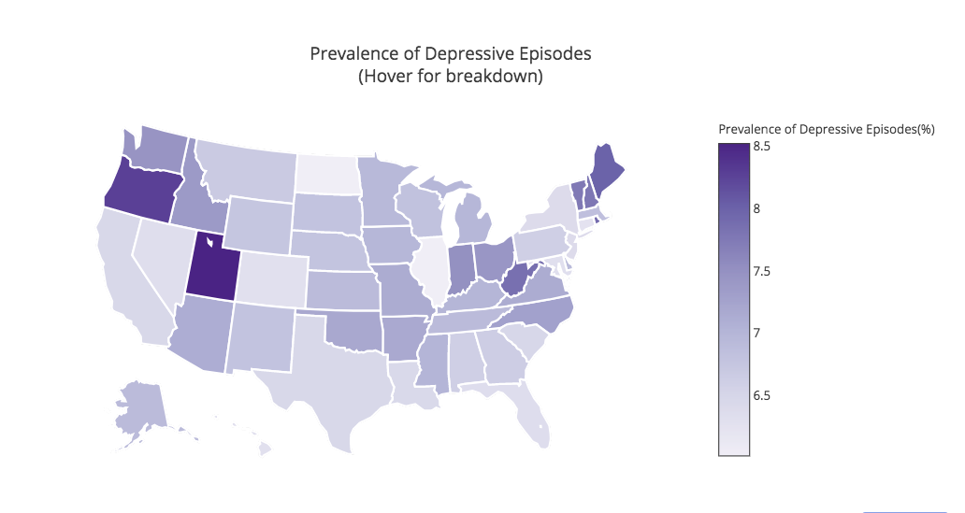
Concentration of depression:

Slide 14
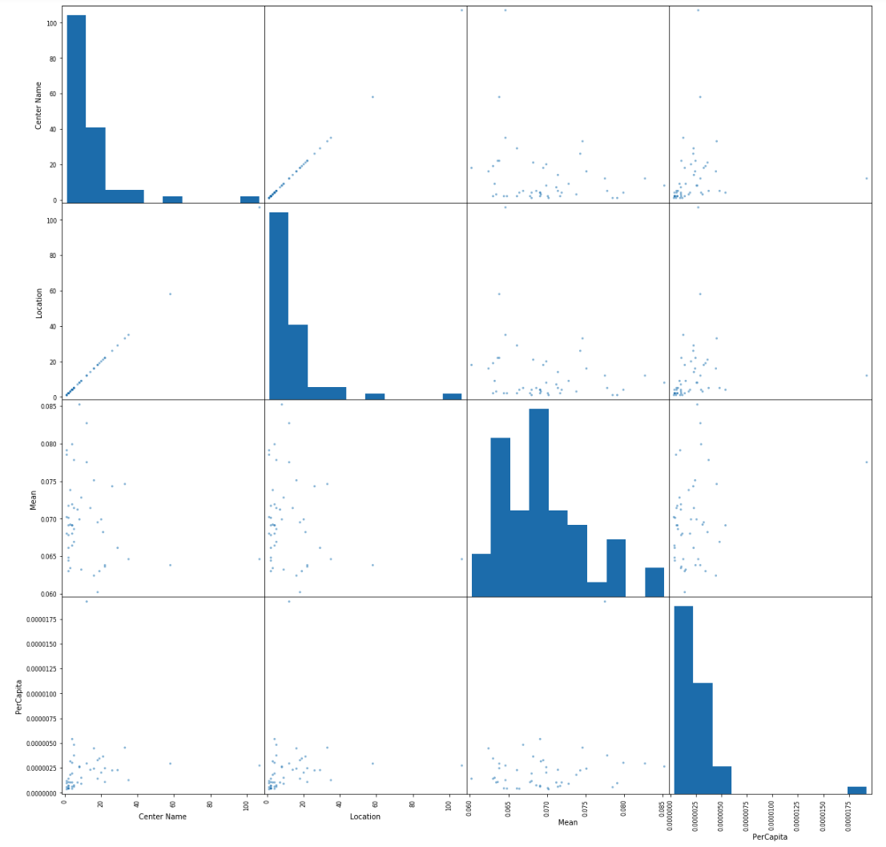
Regression analysis:

Slide 15
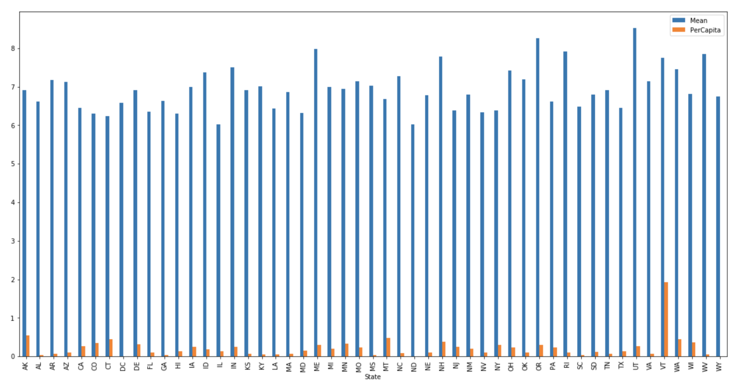
Comparison bar:

Slide 16
Summary:
Takeaways
Scraping, charting, and data manipulation (with python)
Combining multiple data sets
Future Improvements
Graph formatting
Better regression analysis
Different variables, multivariate analysis

